Slide 1
Online Analytic Processing
Carsten Schürmann

Slide 2
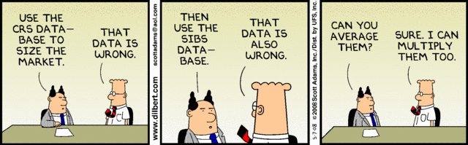

Slide 3
Processing Data
Online Transactional Processing
Short transactions
Simple queries
Touch small portions of the data
Online Analytical Processing
Long transactions
Complex queries
Touch large portions of the data

Slide 4
What’s the Difference?
Data Warehouse
Data from traditional OLTP sources
Use them for OLAP anlaysis
Decision support system (DSS)
Infrastructure for large scale data analysis
OLAP based queries for decision making

Slide 5
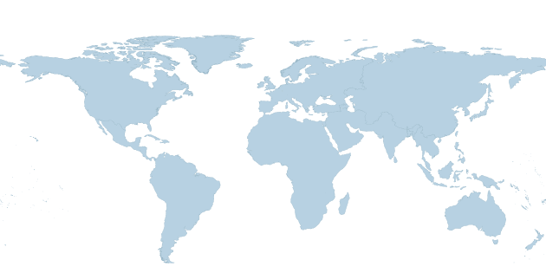
Typical OLAP queries
Which store was best performing?
What year did we sell the most raincoats?
What is our revenue in Europe, Asia, or North America?
Which markets shows signs of growth?
Which markets shows signs of economic slowdown?

Slide 6
Fact Table
Properties:
Can grow very large
Sometimes append only
Examples:
Sales transactions
Visit of webpages
Astronomical data

Slide 7
Star Schema
SALES
Times
Locations
Products
Fact Table
Dimension Table

Slide 8
Snowflake Schema
SALES

Slide 9
A Relational Data Layout
Dimension Attributes
Dependent Attributes
TIMES
timeid
date
week
month
quarter
year
holiday_flag
SALES
(Fact table)
pid
timeid
locid
price
qty
PRODUCTS
LOCATIONS
pid
pname
category
price
locid
city
state
country

Slide 10
The Engine is Still Relational
Sales(pid, timeid, locid, price,qty)
Times(timeid, date, week, month, quarter, year, holiday_flag)
Products(pid, pname, category, price)
Locations(locid, city, municipality)
Fact Table
Dimension Table

Slide 11
Executing OLAP Queries
Join, Filter, Group, Aggregate
Sales(pid, timeid, locid, price, qty)
Times(timeid, date, week, month, quarter, year, holiday_flag)
Products(pid, pname, category, price)
Locations(locid, city, municipality)

Slide 12
Adressing Performance Concerns
Need to think about data differently
Data cube
Optimized operations
Need to use really fast algorithms
Highly-specialized bitmap indexes
Pre-aggregation/Materialized Views

Slide 13
Performance #1: Data Cube
Multi-dimenisional OLAP
Operations
Drill-Down and Roll-Up
Pivoting
Slicing and Dicing
Products
Locations
Times

Slide 14
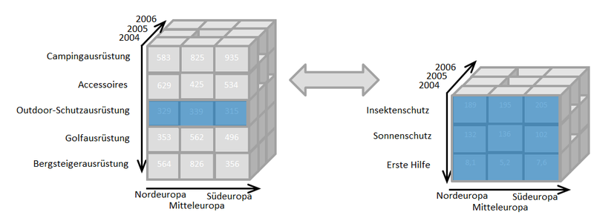
Drill-Down / Roll-Up
SELECT year, state, SUM(qty * price)
FROM Sales S, Times T, Locations L
WHERE S.timeid=T.timeid AND S.locid=L.locid
GROUP BY year, state

Slide 15
Drill-Down / Roll-Up
SELECT year, category, state, SUM(qty * price)
FROM Sales S, Times T, Locations L
WHERE S.timeid=T.timeid AND S.locid=L.locid
GROUP BY year, category, state

Slide 16
Drill-Down / Roll-Up
SELECT year, state, SUM(qty * price)
FROM Sales S, Times T, Locations L
WHERE S.timeid=T.timeid AND S.locid=L.locid
GROUP BY year, state

Slide 17
Drill-Down / Roll-Up
SELECT year, state, SUM(qty * price)
FROM Sales S, Times T, Locations L
WHERE S.timeid=T.timeid AND S.locid=L.locid
GROUP BY year, state

Slide 18
New SQL Standard
SELECT a,b,… GROUP BY CUBE (a,b)
produces a table that contains the aggregate grouped by all subets of {a,b}.
(SELECT a,b … GROUP BY a,b) UNION
(SELECT a,null,… GROUP BY a) UNION
(SELECT null,b … GROUP BY b) UNION
(SELECT null,null, …)

Slide 19
Performance #2: Bitmap-Indexes
Dimensions with low cardinality
Years: 2013, 2014, 2015, 2016
Quarters: Q1, Q2, Q3, Q4
Locations: Store1, Store2, Store3
Representation as bits
Years: 00, 01, 10, 11
Quarters: 00, 01, 10, 11
Locations: 00, 01, 10

Slide 20
Basic bitmap index
Bit operations are really fast!
2013 | 2014 | 2015 | 2016 | RID
0 | 0 | 1 | 0 | 1
1 | 0 | 0 | 0 | 2
1 | 0 | 0 | 0 | 3
0 | 1 | 0 | 0 | 4
0 | 0 | 0 | 1 | 5

Slide 21
… But
There are issues, especially when
Selective dimension
High cardinality
Solution: Compress indexes
aka. bitmap indexes

Slide 22
Bitmap Index Support
Key features: WAH is compute-efficient because it
Uses the run-length encoding (simple)
Allows operations directly on compressed bitmaps
Never breaks any words into smaller pieces during operations
31 bits
31 bits
…
31 bits
Merge neighboring groups with identical bits
31 bits
Count=63 (31 bits)
31 bits
Encode each group using one word

Slide 23
Bitmap Index Support
MySQL: Not supported.
Oracle:
CREATE BITMAP INDEX ON sales(pid)
Some non-relational systems like FastBit work entirely with compressed bitmap representations of sets.
Notes:
Check tip!

Slide 24
Pre-aggregation
Idea: Precompute certain aggregates that can be used to answer queries quickly.
Examples:
Precompute the number of sales and average sales price for each dealer.
Allows us to quickly find e.g. the number of sales for each country.

Slide 25
Materialized views
Recall: A view is similar to a macro. CREATE VIEW MyView AS SELECT * FROM Sales S, Times T, Locations L WHERE S.timeid=T.timeid AND S.locid=L.locid
In contrast, a materialized view physically stores the query result.
Can be updated automatically
Can be indexed!
Notes:
Philosophical note: Does not need to be represented the same way as a table. Apptus point of not mixing abstract view with implementation.

Slide 26
Materialized views (cont’d)
Materialized view is created: CREATE MATERIALIZED VIEW SalaryByLocation AS SELECT location_id, country_id, SUM(salary) AS s FROM Employees NATURAL JOIN Departments NATURAL JOIN Locations GROUP BY location_id, country_id
Materialized view is used: SELECT country_id, SUM(salary) AS salary FROM SalaryByLocation GROUP BY country_id

Slide 27
Introduction to Data Mining
Carsten Schürmann

Slide 28
Relation with Geo Data
x | y | cid
55.660176 | 12.591518 | 1001
55.676235 | 12.574616 | 1004
55.675767 | 12.569444 | 1003
55.70220 | 12.582354 | 1015

Slide 29

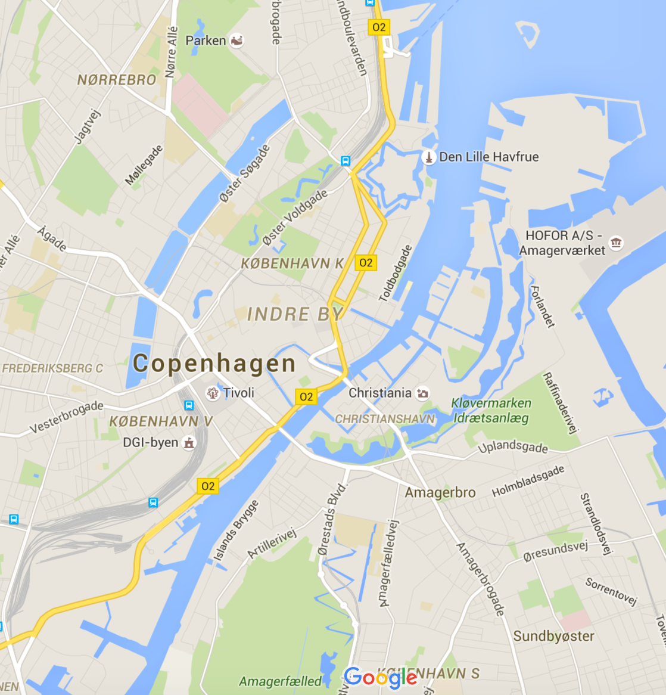
Possible Queries
Where should we open a new store?
How many stores shall we open?

Slide 30
Data Mining
Information Retrieval
Clustering
Regression
Classification Trees

Slide 31
What is it?
Data-mining is the science of discovering structure and making predictions in datasets
Unsupervised learning: Structure
Given observations X₁, X₂, …, X_{n} learn group structure based on similarity
Supervised learning: Predictions
Given observations and classifications
(X₁, Y₁), (X₂, Y₂), …, (X_{n}, Y_{n}) learn a model
to predict Y from X

Slide 32
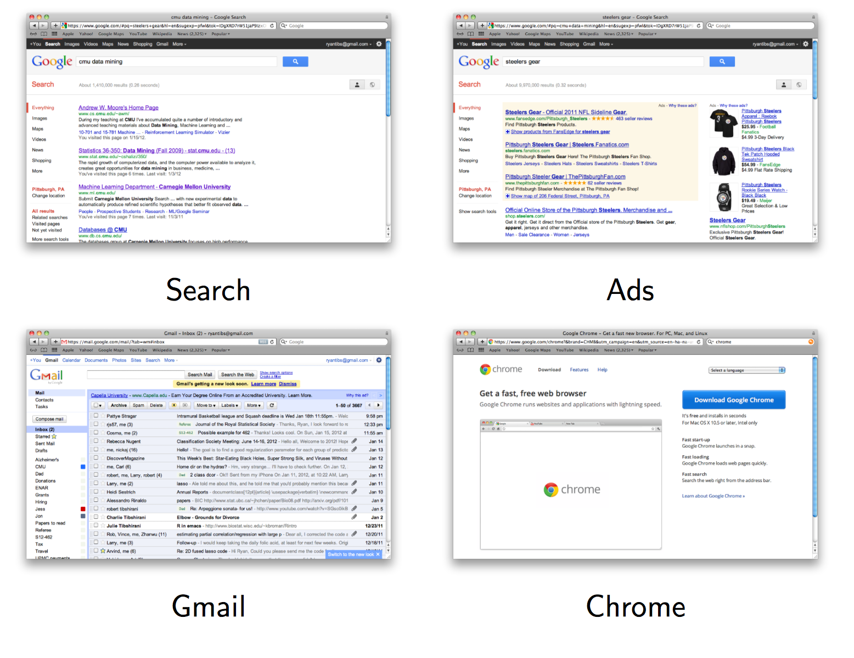
Google

Slide 33


Slide 34


Slide 35

Airfare Prediction

Slide 36
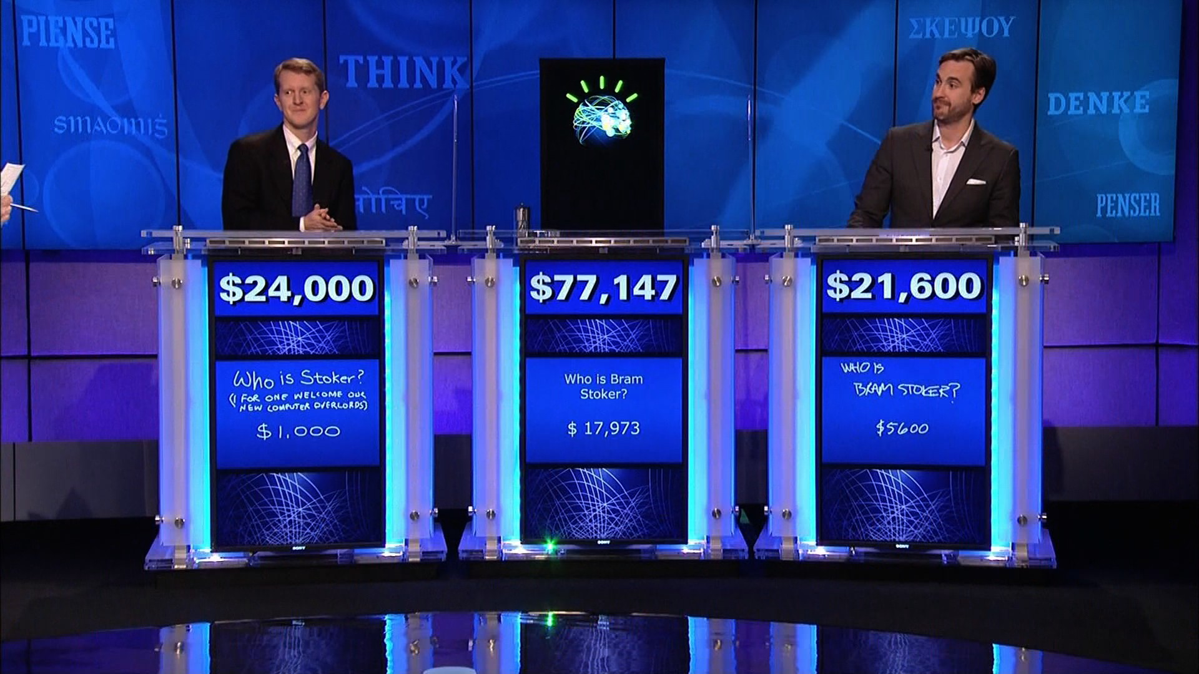
IBM’s Watson in Jeopardy
https://youtu.be/WFR3lOm_xhE

Slide 37
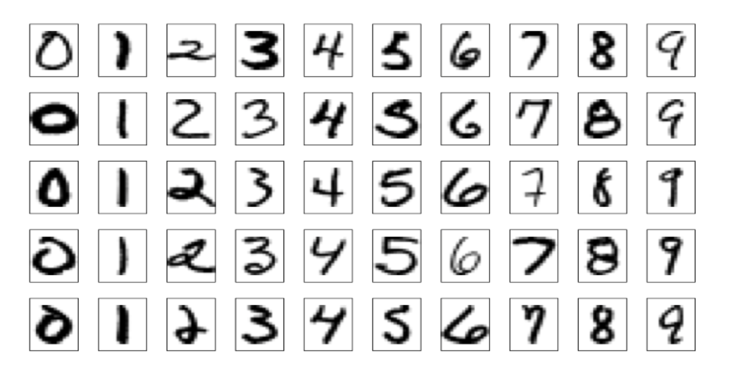
Handwritten Postal Codes

Slide 38
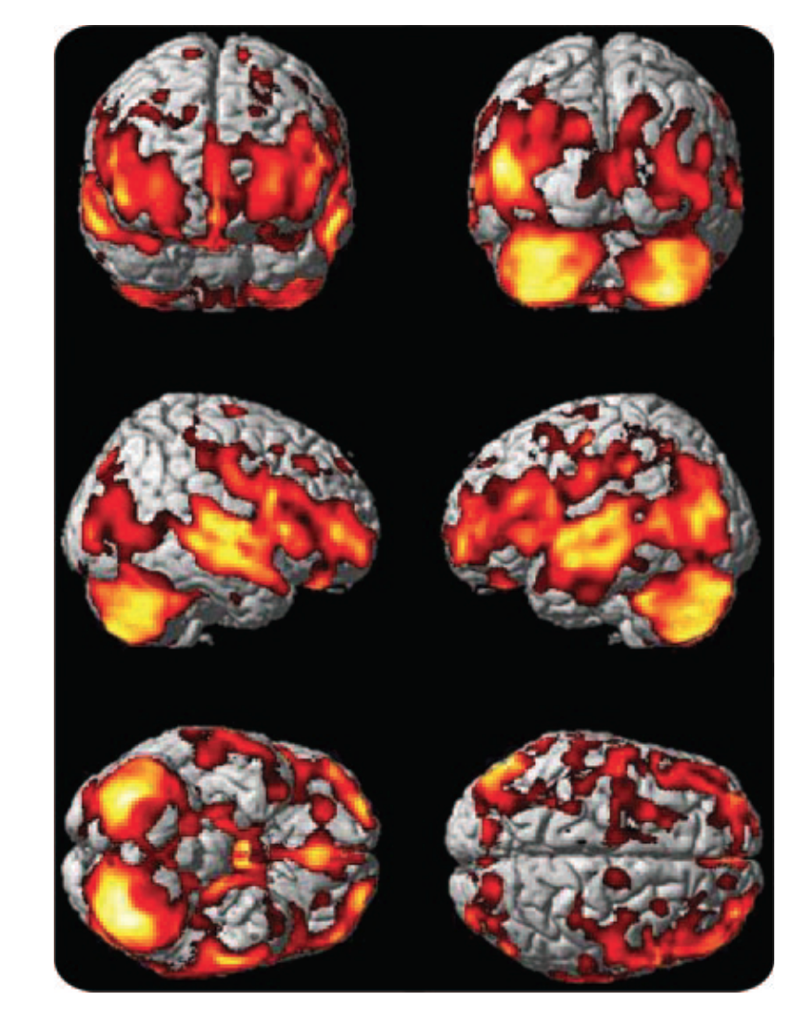
Predicting Alzheimer’s Disease

Slide 39
Bias-Variance Dilemma
Bias: error from erroneous assumptions in the learning algorithm. High bias leds to underfitting.
Variance: is error from sensitivity to small fluctuations in the training set. High variance can cause overfitting.

Slide 40
Information Retrieval

Slide 41
Text Similarity
Documents:
X₁: “John loves statistics” X₂: “Jess hates, hates statistics”
Query:
Y: “hates statistics”
Document-term matrix:
 | hates | Jess | loves | Ryan | statistics
X₁ | 0 | 0 | 1 | 1 | 1
X₂ | 2 | 1 | 0 | 0 | 1
Y | 1 | 0 | 0 | 0 | 1

Slide 42
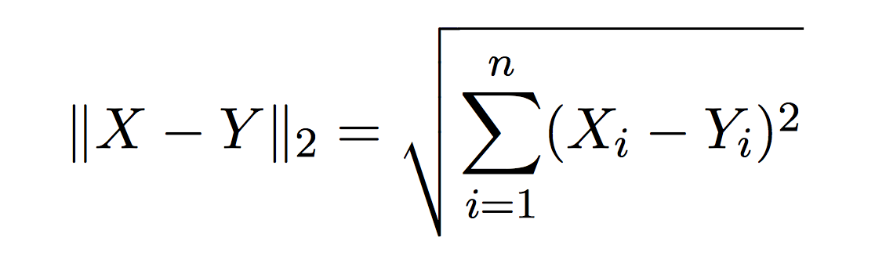
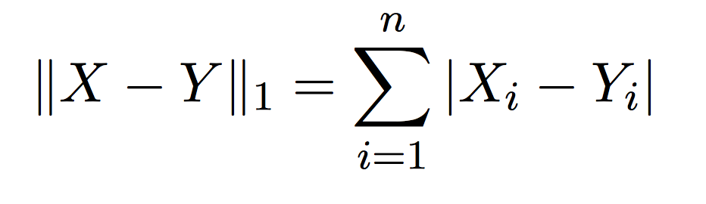
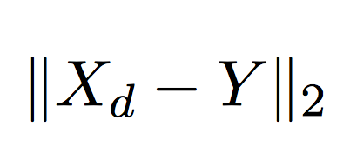
Vectors, Metrics, Retrieval
Euclidian distance:
Manhattan distance:
Retrieval: Find d, with shortest distance to the query: minimal

Slide 43

Page Rank
Central idea behind
Assign a rank to each page
Compute the rank from the linking edges weighted appropriately by their own page rank
“Recursive definition”
Page rank algorithm, computes the rank, i.e. importance of each page iteratively
Ingredients. Matrices, Markov chains.

Slide 44
Clustering

Slide 45
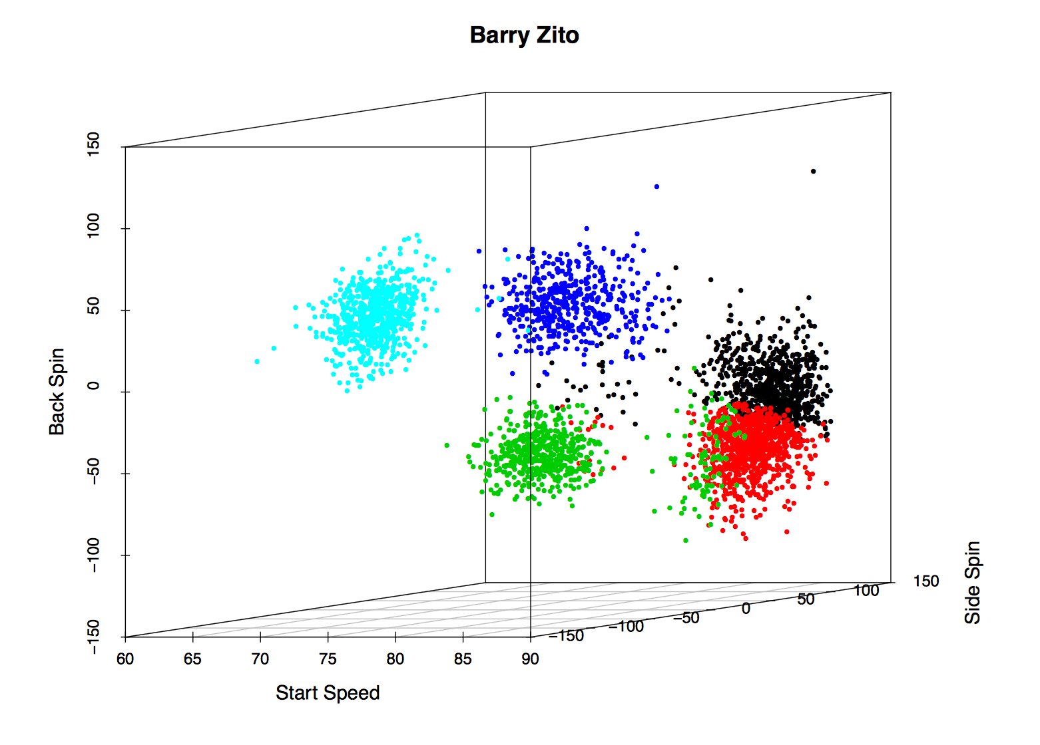
Baseball Pitches
Inferred meaning of clusters: black – fastball, red – sinker,
green – changeup, blue – slider, light blue – curveball

Slide 46
k-Means Clustering
Given: n vectors (representing observations x_{i})
Problem: Find k clusters (centered in c_{k})
Step 1: Place c_{k} at random in the space
Step 2: Assign each x_{i} to the closest c_{k}.
Step 3: Compute new centers c_{k} among those assigned.
Step 4: Goto step 2 until stable.

Slide 47
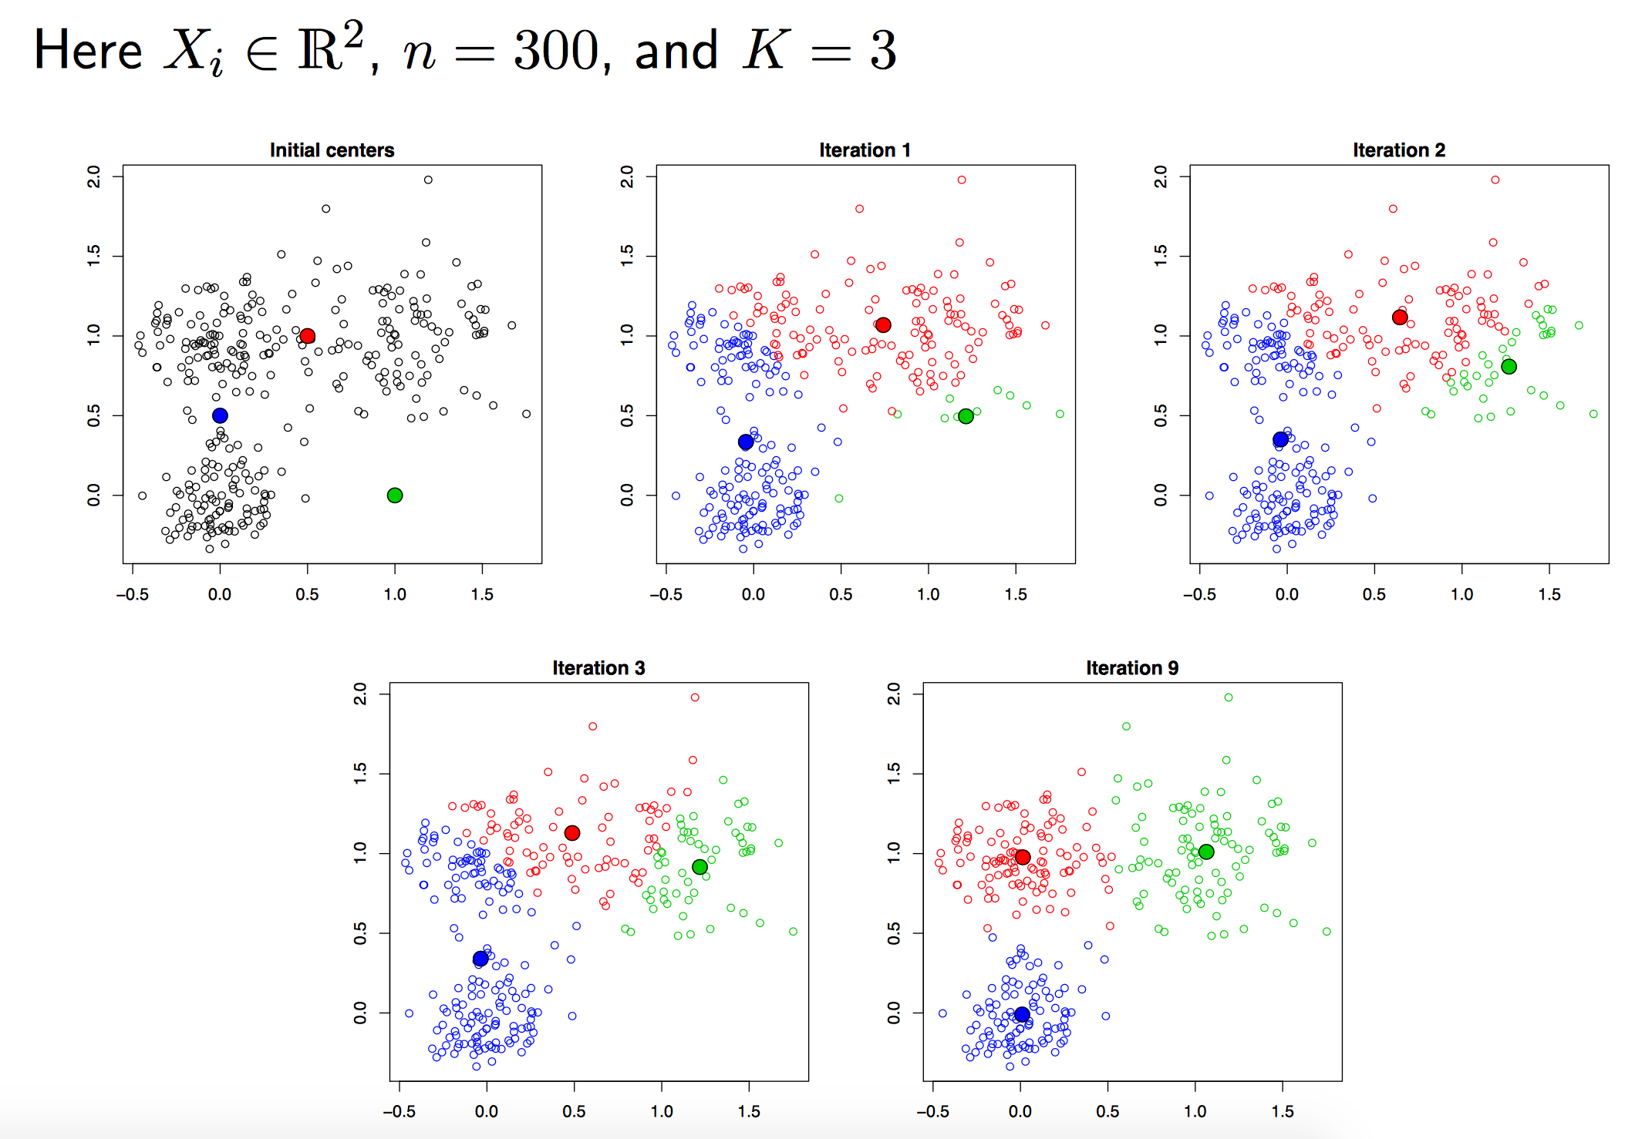

Slide 48
Properties of k-Means Clustering
Always reduces the distance
Always converges
May not converge in a global maximum

Slide 49
Hierarchical clustering algorithm
Given: n vectors (representing observations x_{i})
Problem: Find k clusters (centered in c_{k})
Step 0: Every vector forms a group
Step 1: Find nearest neighboring groups
Step 2: Merge them
Step 3: Goto 1 until there is only one group

Slide 50
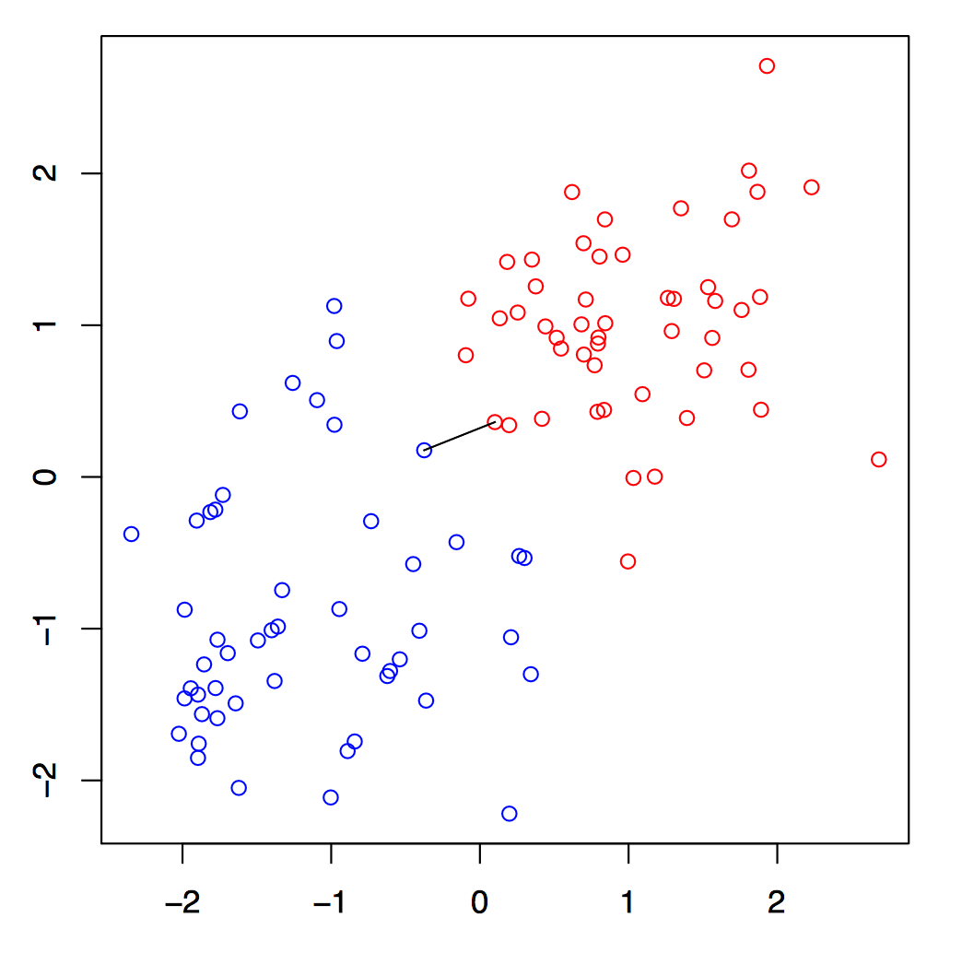
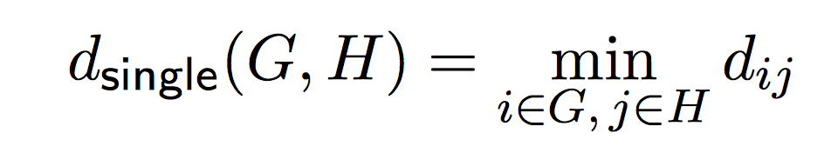
Single Linkage

Slide 51
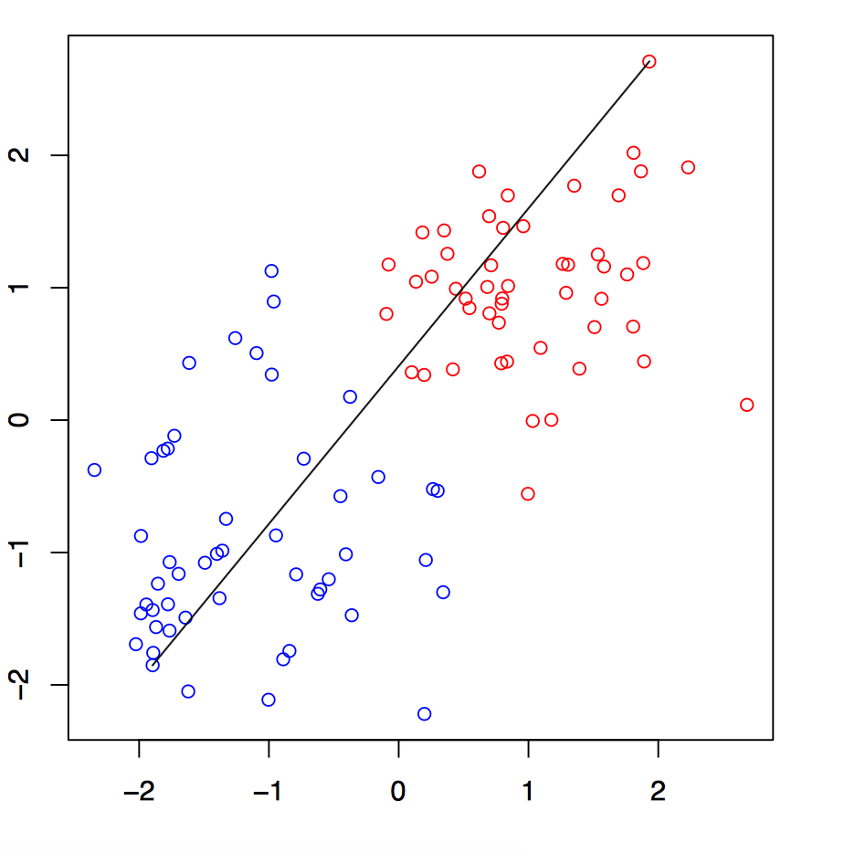
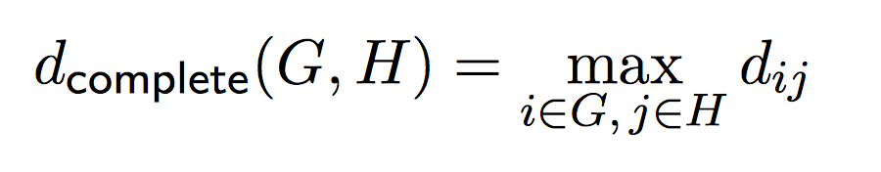
Complete Linkage

Slide 52
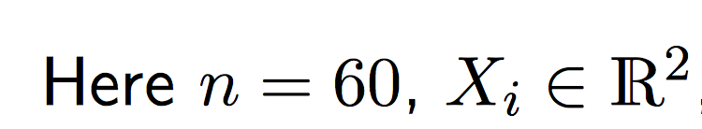
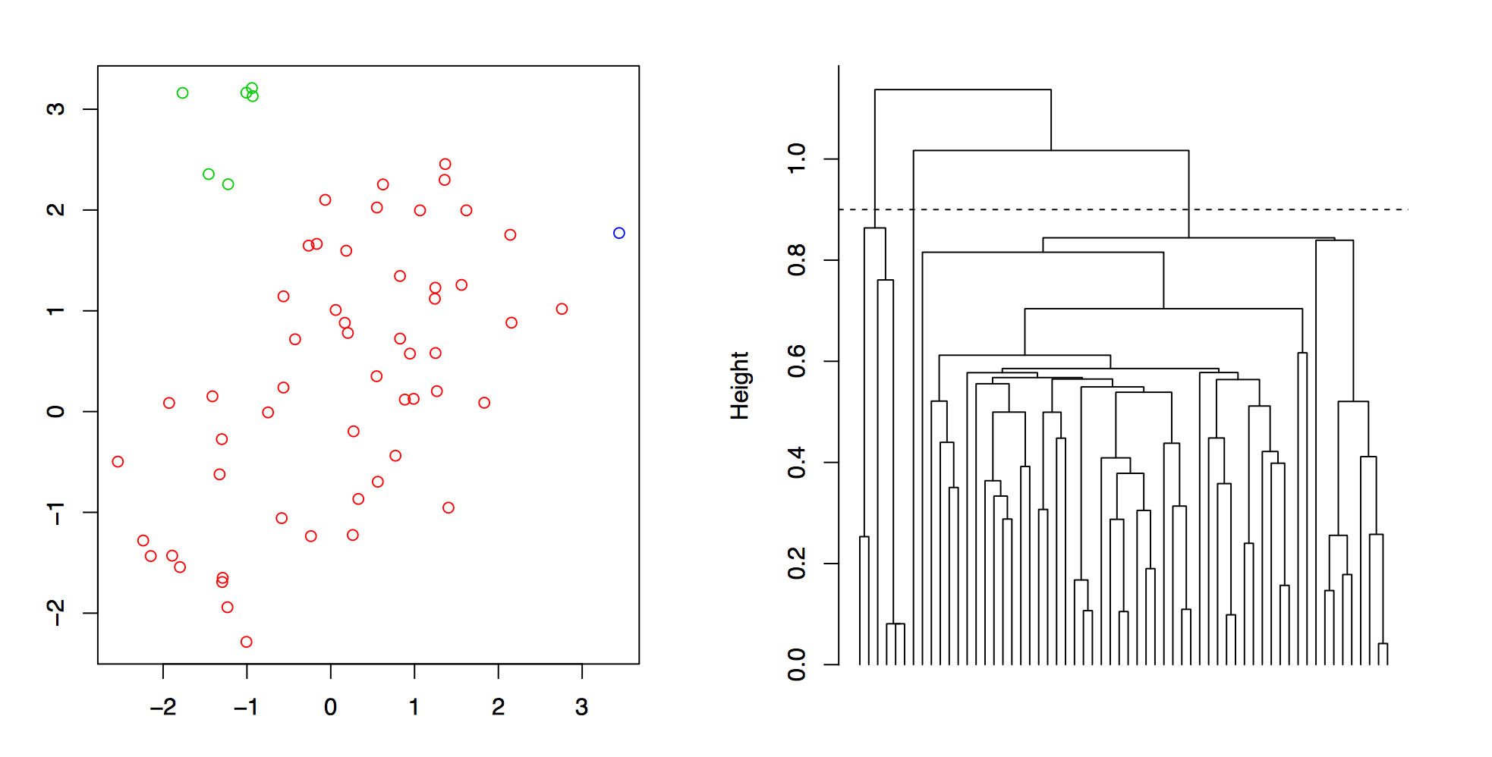

Slide 53
Properties
Single linkage avoids crowding but suffers from chaining.
Complete linkage avoids chaining, but suffers from crowding.
There is also average linkage
(not discussed here)

Slide 54
Regression

Slide 55
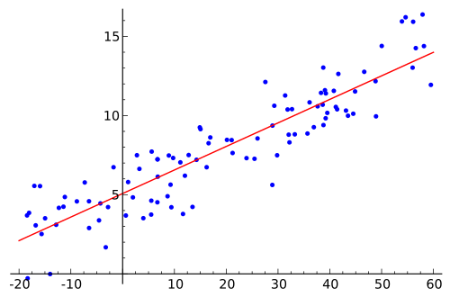
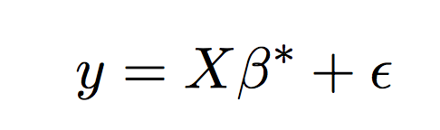
Linear regression

Slide 56
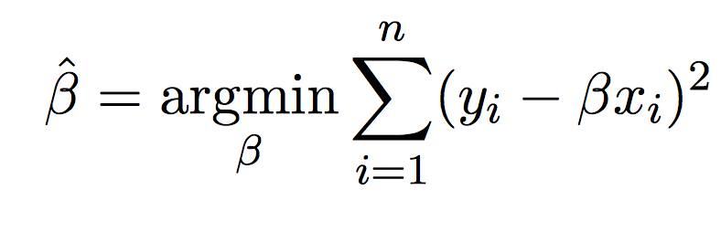
Least Square method
Compute the “best” coefficients that minimizes the squared error.
This is somewhat easy (Gauss figured it out when he was 18), but modern regression methods can get very very difficult

Slide 57
Classification Trees

Slide 58
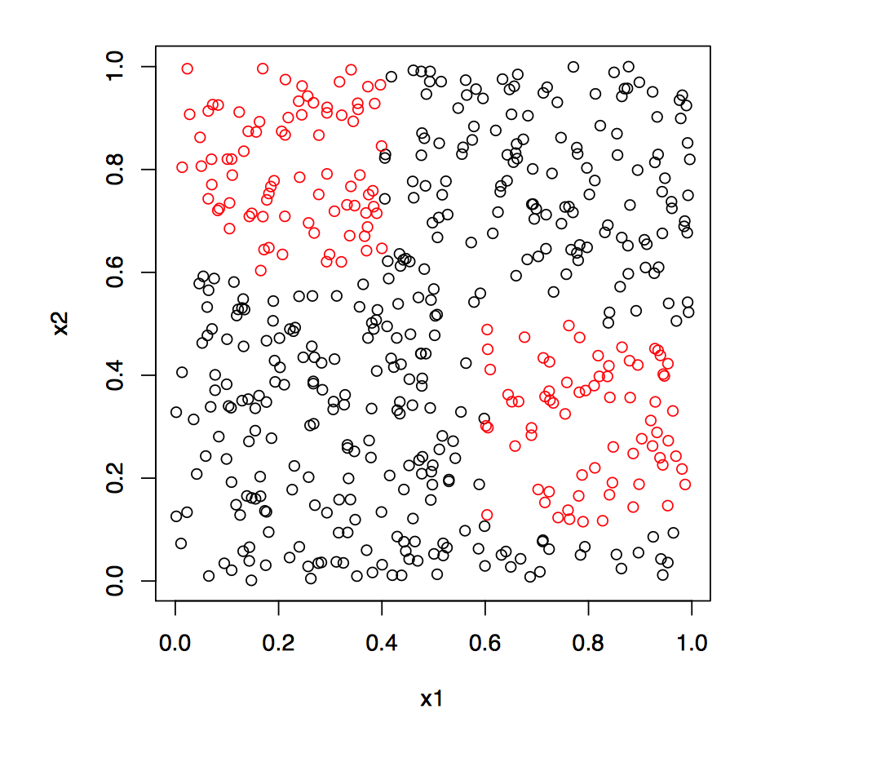
Example

Slide 59
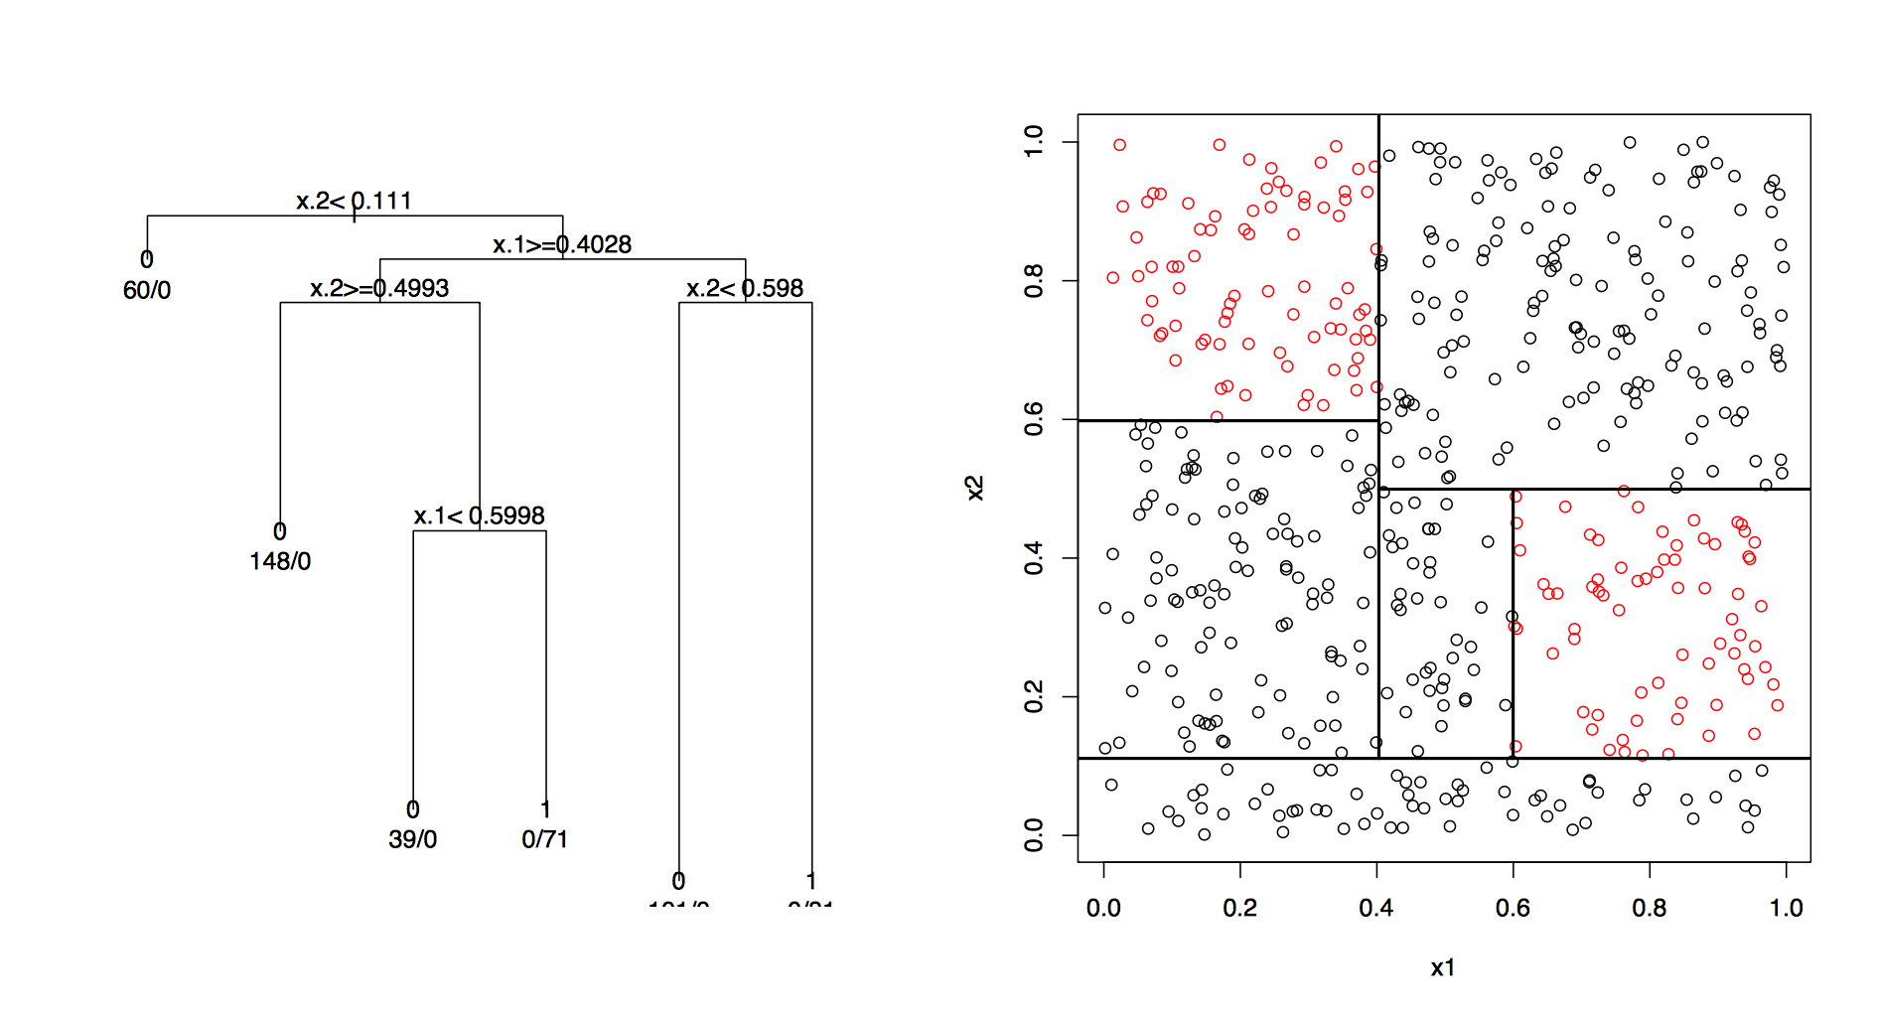
And the Classification Tree

Slide 60
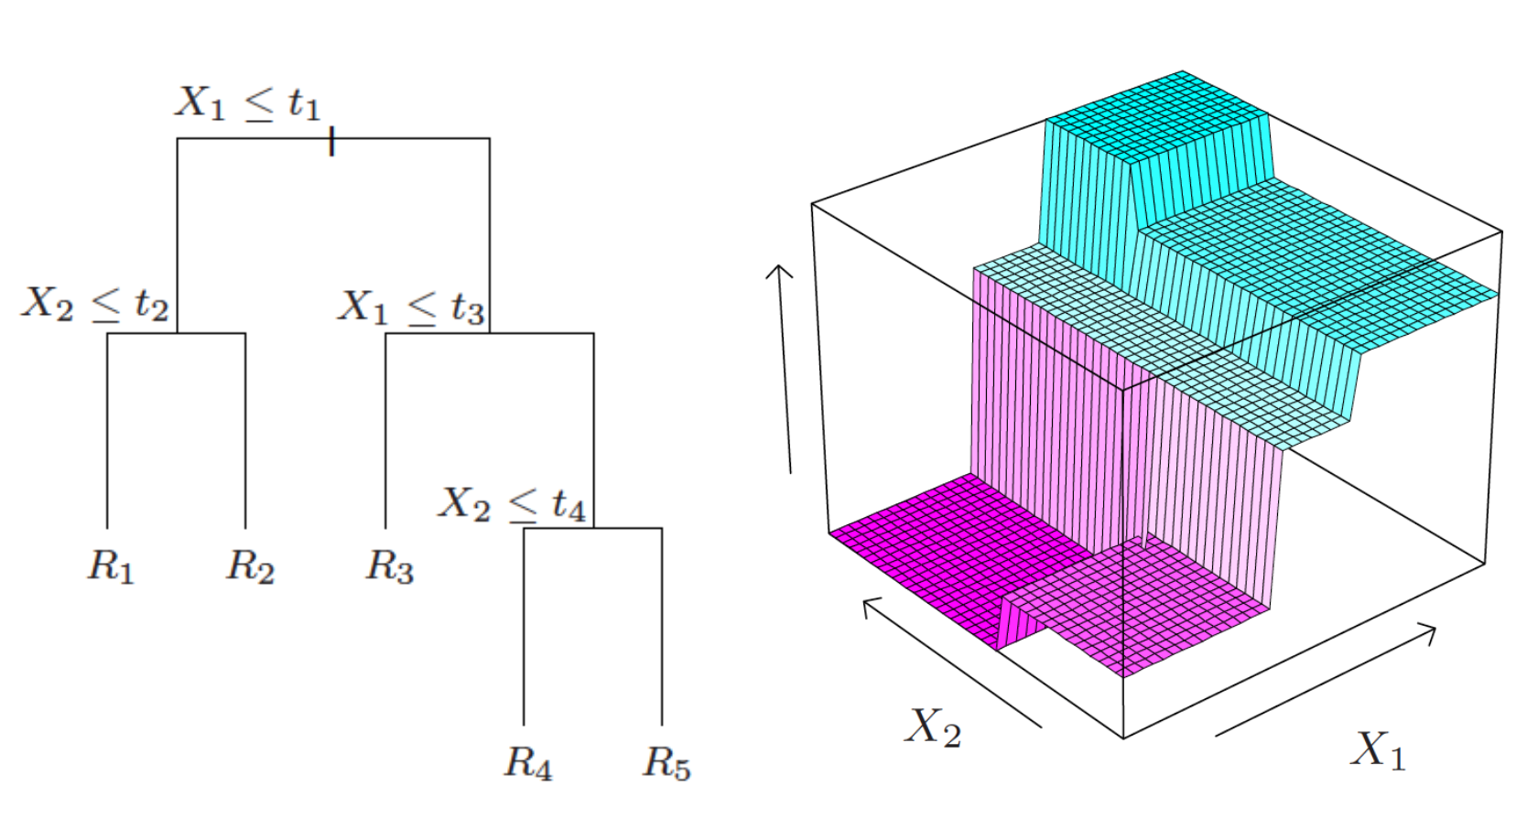
Continuous Classification Trees

Slide 61
Properties
Predicative abilities: Not so good.
Overfitting: if the granuarlity of the tree is too fine, then predictive abilities are even worse

Slide 62
Conclusion
Exact approach versus approximation: often when we can’t do something exactly, we’ll settle for an approximation. Can perform well, and scales well computationally to work for large problems
Bias-variance tradeoff: nearly every modeling decision is a tradeoff between bias and variance. Higher model complexity means lower bias and higher variance
Interpretability versus predictive performance: there is also usually a tradeoff between a model that is interpretable and one that predicts well under general circumstances

